Slide 1
Scrum Report 4

Slide 2

Team members
Tanner Terrio [Master]
Kobe Swier
Andy Yong

Slide 3

Objective
Creating a Java-based HTML-JSP-Java Web Application and an XML-SOAP-Java Web Service Provider based on a shared Team4_Shark_API class.
Developing a Team4_Shark_API class with a createShark( ) method that generates Team4_Shark objects with at least three shark-related properties.
Building an HTML form and JSP page to accept user input, invoke the API, and display the shark properties in the web application.
Implementing a SOAP Web Service test client to input, transmit, and display shark data using the createShark( ) method.

Slide 4
Code Explanation
Team4_Shark.java
Defines the Team4_Shark class with methods for retrieving and updating shark attributes such as species, length, and habitat. Provides constructors for creating shark instances with or without initial values, ensuring flexible object creation and data management.

Slide 5
Code Explanation
Team4_Shark_API.java
Defines the Team4_Shark_API class with a method for creating new shark objects by specifying species, length, and habitat. Facilitates streamlined shark instance creation for use within the application.

Slide 6
Code Explanation
Team4_Shark.html
Creates an HTML form for entering shark details including species, length, and habitat. Submits user input via POST method to the Team4_Shark.jsp page for further processing.

Slide 7
Code Explanation
Team4_Shark.jsp
Implements a JSP page that retrieves shark details from an HTML form, creates a shark object using the Team4_Shark_API class, and displays the created shark’s species, length, and habitat to the user.

Slide 8
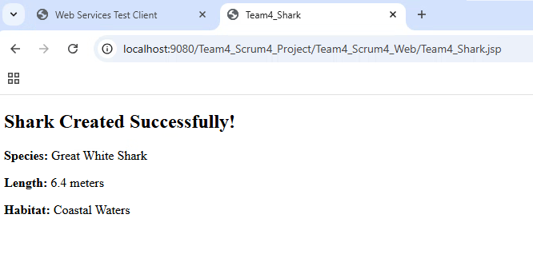
I/O Screenshots

Slide 9
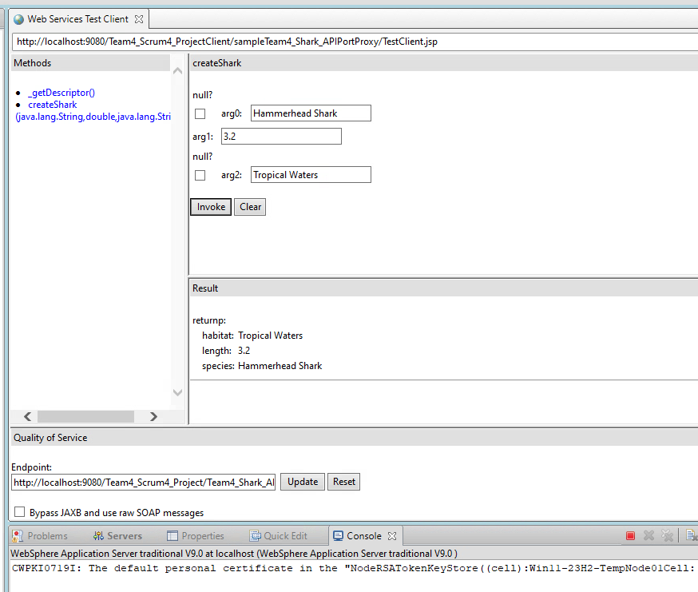
I/O Screenshots

Slide 10
Challenges
Issue 1
Web Service Deployment Failures
While setting up the XML-SOAP Web Service Provider, there were instances where deployment to the server failed due to incorrect WSDL configuration, missing annotations, or server compatibility issues. This resulted in errors like "Service Endpoint Interface not found" or "WSDL publishing failed," preventing the client from successfully accessing the web service.
Issue 2
Input Data Handling Errors
During development of the web application, there were cases where user inputs from the HTML form were not properly passed to the JSP page due to mismatched form field names or missing request parameters. This led to null values being sent to the API, causing incomplete Team4_Shark objects or runtime exceptions when trying to display the shark properties.

Slide 11

Solutions
Solution 1
We ensured a stable database connection by verifying credentials, configuring environment variables correctly, and implementing error handling for failed connections.
Solution 2
We carefully reviewed JavaScript functions, fixed syntax errors, and ensured event listeners were properly attached. Console debugging and thorough testing helped resolve functionality issues, ensuring dynamic features like menu filtering and form validation worked as expected.

Slide 12

Thank you

